Slide 1
Crowd Counting in 2019
Wang Jian

Slide 2
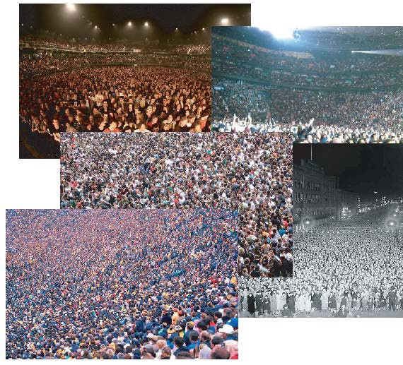
Problem Definition
Estimate the number of people in an image.

Slide 3
Previous Methods
Detection-based methods
Use a moving window-like detector to identify people in an image and count. These methods do not perform well on crowded images as most of the target objects are not clearly visible.
Regression-based methods
We first crop patches from the image and then, for each patch, extract the low level features and directly estimate the numbers.
Density estimation-based methods
We first create a density map for the objects. Then, the algorithm learns a mapping between the images and their object density maps.

Slide 4
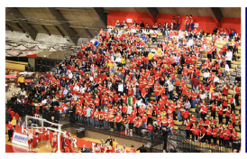
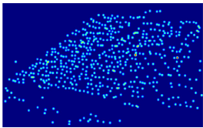
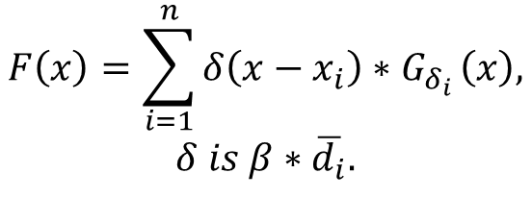
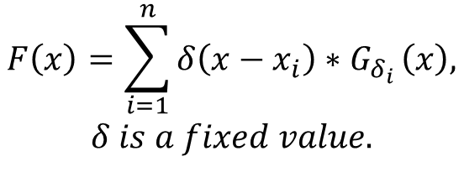
Density map Generation
$$F\left(x\right)=\sum_{i=1}^{n}{δ\left(x−x_{i}\right)∗G_{δ_{i}}}\left(x\right),$$
$$δ is a fixed value.$$
$$F\left(x\right)=\sum_{i=1}^{n}{δ\left(x−x_{i}\right)∗G_{δ_{i}}}\left(x\right),$$
$$δ is β∗\overline{d_{i}}.$$

Slide 5
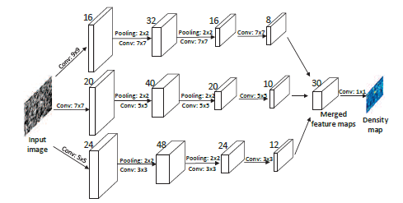
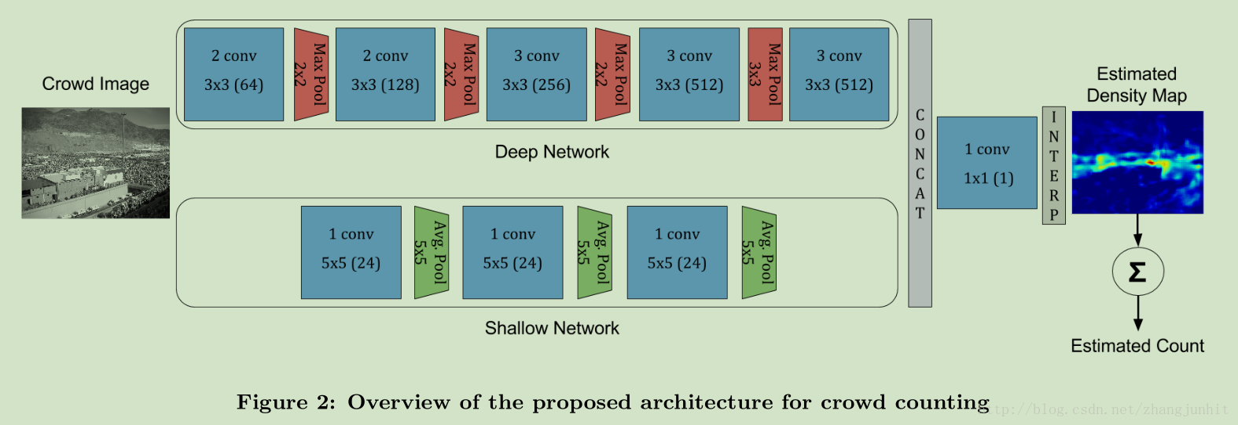
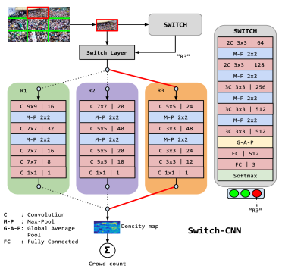
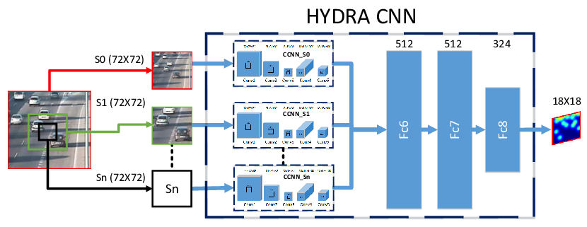
Network Architectures

Slide 6
CVPR2019 Papers
Network/ Multi-Scale Fusion
Network/ Attention
Network/ Localization
Network/ Perspective
Data/ Unsupervised
Loss

Slide 7
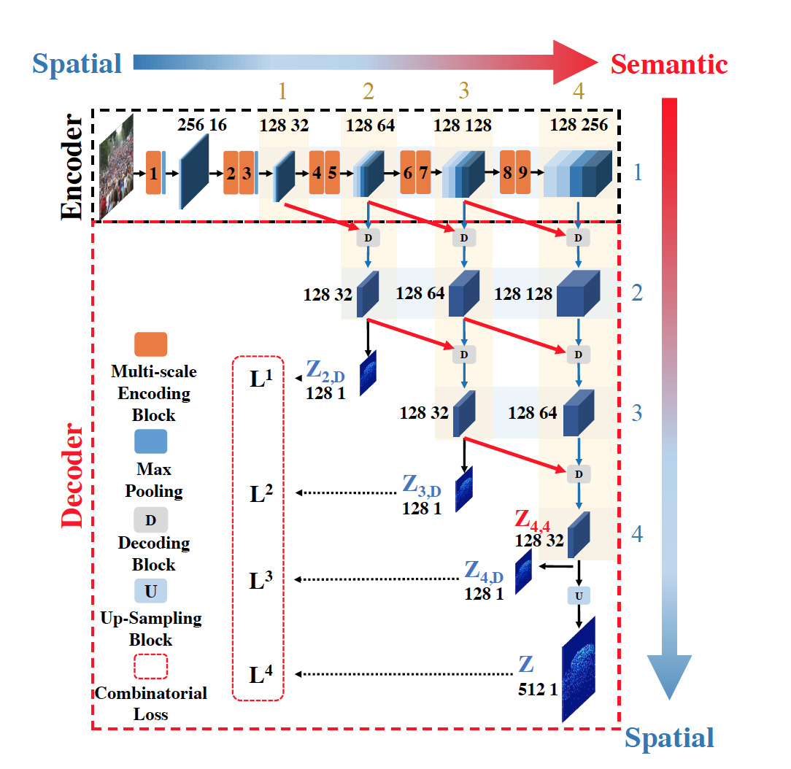
Trellis Encoder-Decoder Networks
Multi-Scale Fusion in Decoder
Distributed Supervision (Intermediate Supervision)
Spatial Abstraction Loss & Spatial Correlation Loss
Notes:
前人的工作都是基于cnn的深层网络将浅层空间信息转换成高层语义丰富的特征。因此，随着下采样的进行，特征图的分辨率逐渐下降，定位精度进一步降低。因此，需要在空间分辨率和语义特征提取两方面取得平衡。原先的hourglass网络结构只有单个decoding路径，过度的下采样和上采样牺牲了像素级精度。1）encoding阶段下采样倍数减少为4；
2）decoding阶段多级路径对不同尺度特征进行融合，每一级单独输出map并进行监督训练；

Slide 8
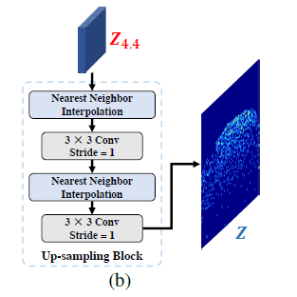
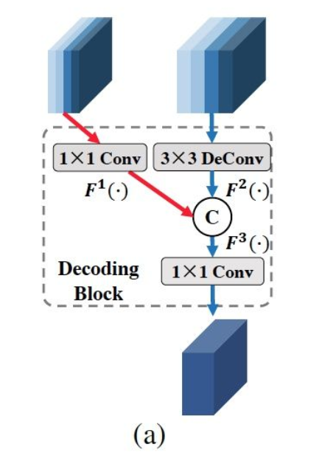
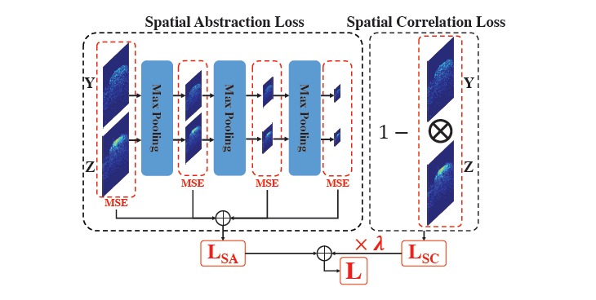
Trellis Encoder-Decoder Networks
Architecture
Notes:
) Spatial Abstraction Loss
在预测map和真值map之间逐步增加计算的stride，增大每个尺寸的感受野。每个抽象级的特征map通过stride为2的max pooling实现。
Spatial Abstraction Loss是块级别的监督loss，Spatial Correlation Loss则是像素级的，通过 归一化相关性系数得到。

Slide 9
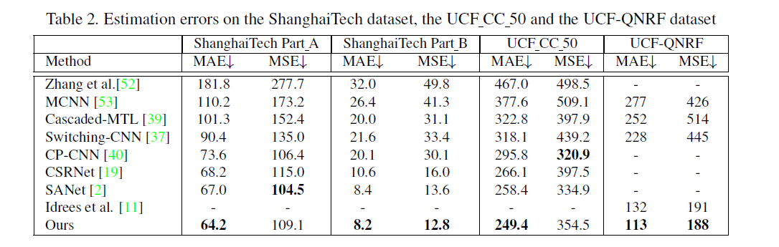
Trellis Encoder-Decoder Networks
Results

Slide 10
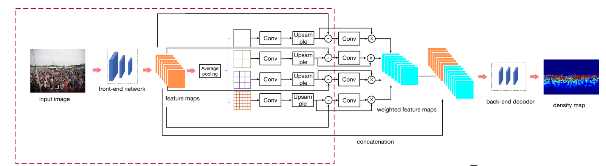
Context-Aware Crowd Counting
Contributions
Incorporates multi-scale contextual information directly into an end-to-end trainable crowd counting pipeline, and learns to exploit the right context at each image location.
Architecture

Slide 11
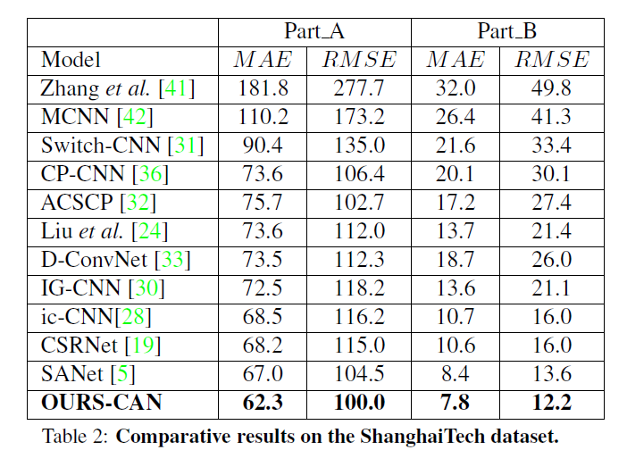
Context-Aware Crowd Counting
Results

Slide 12
Recurrent Attentive Zooming for Joint Crowd Counting and Precise Localization
Contributions
A novel deep model for precise localization.
A normalized variant of Binary Cross Entropy loss
Recurrent attention learning of zooming regions.
Solve counting and localization in a mutually reinforced way.
New evaluation protocol

Slide 13
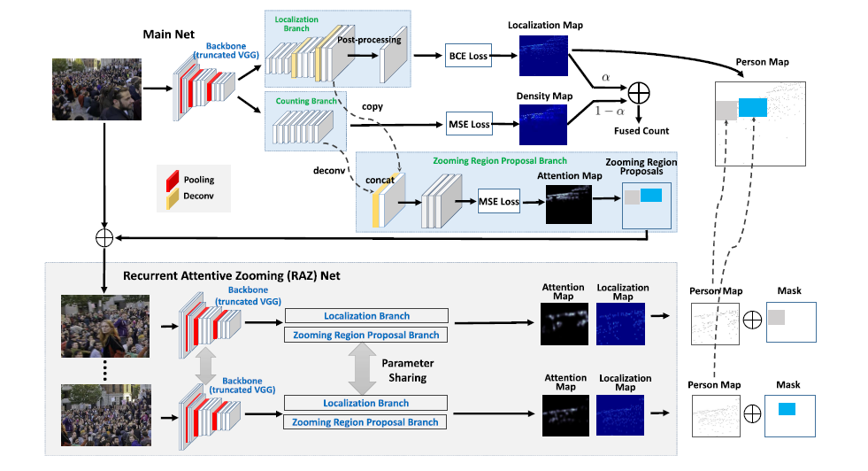
Recurrent Attentive Zooming for Joint Crowd Counting and Precise Localization
Architecture

Slide 14
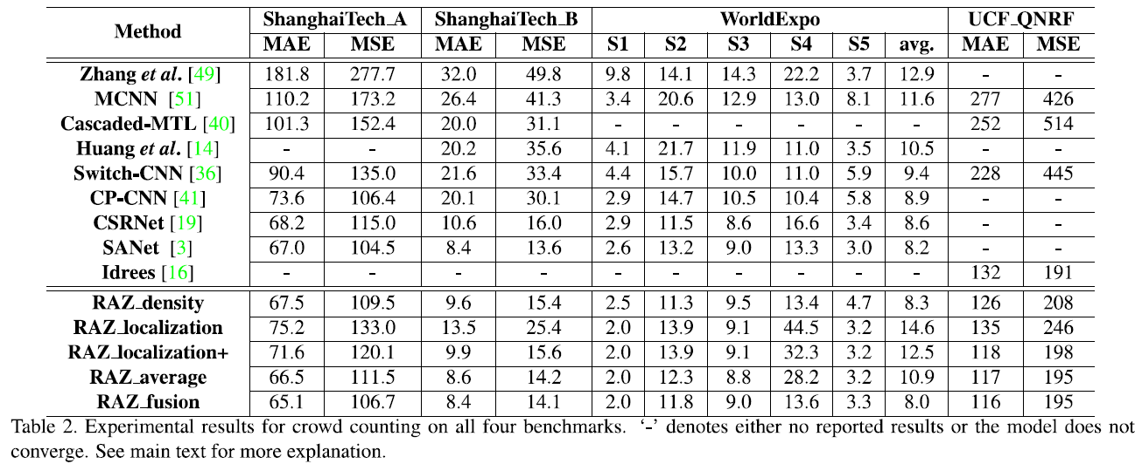
Recurrent Attentive Zooming for Joint Crowd Counting and Precise Localization
Results

Slide 15
Point in, Box out
Contributions
A novel online pseudo ground truth updating scheme.
Initializes the pseudo GT bboxes from point-level annotations
Iteratively updates them during training.
A novel locally-constrained regression loss which encourages the predicted boxes in a local band area to have the similar size.
A curriculum learning strategy to feed the network (from easy to hard)

Slide 16
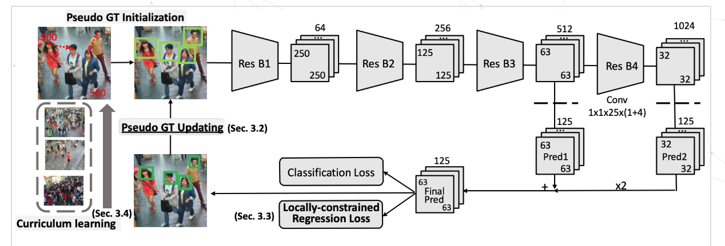
Point in, Box out
Architecture

Slide 17
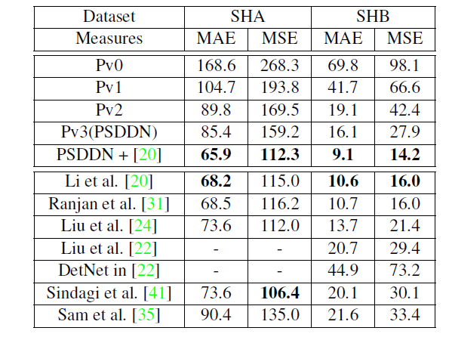
Point in, Box out
Results

Slide 18
Residual Regression with Semantic Prior for Crowd Counting
Contributions
A novel approach of residual regression learning by comparing the
concerned image with a set of support images.
Incorporate a semantic prior to eliminate the side effect of noisy false alarms in the predicted density maps.
An adversarial loss is adopted to enhance the quality of the predicted density maps.

Slide 19
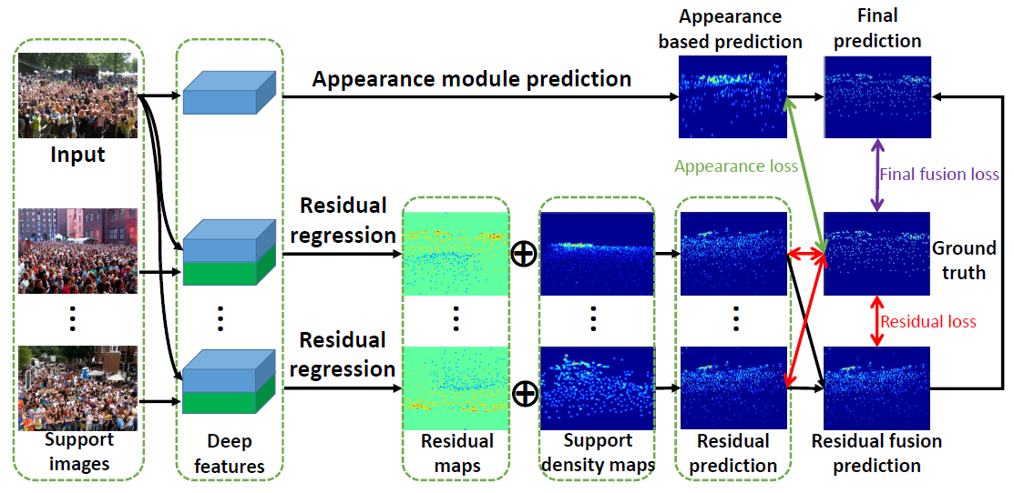
Residual Regression with Semantic Prior for Crowd Counting
Architecture

Slide 20
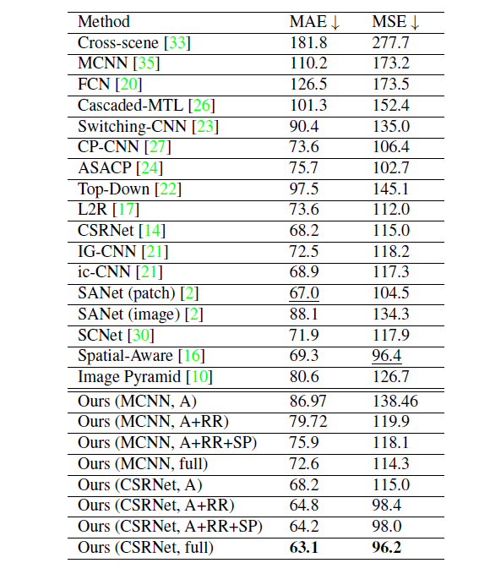
Residual Regression with Semantic Prior for Crowd Counting
Results

Slide 21
ADCrowdNet: An Attention-injective Deformable Convolutional Network for Crowd Understanding
Contributions
A novel attention-injective deformable convolutional network framework
AMG model is innovatively formulated as a binary classification network by introducing third party negative data.
DME model can estimate the crowds effectively by using aggregating multi-scale deformable convolution representations.
Notes:
AMG VGG+Dilated DME VGG Deformable

Slide 22
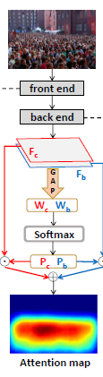
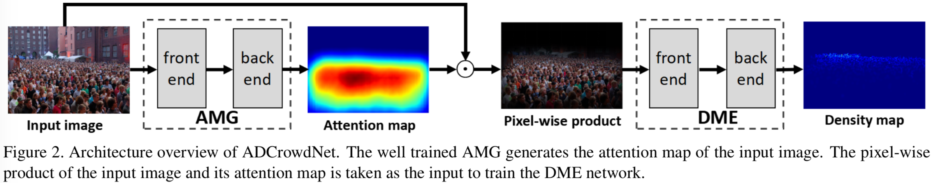
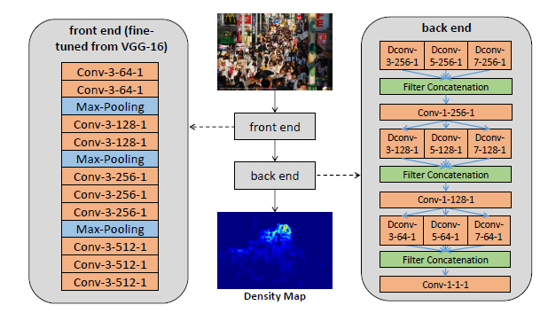
ADCrowdNet: An Attention-injective Deformable Convolutional Network for Crowd Understanding
Architecture
DME
AMG
Notes:
AMG VGG+Dilated DME VGG Deformable

Slide 23
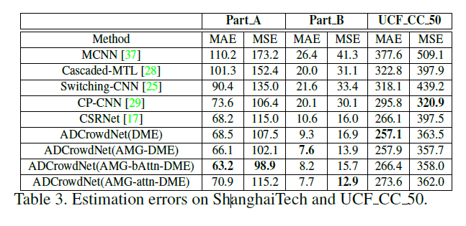
ADCrowdNet: An Attention-injective Deformable Convolutional Network for Crowd Understanding
Results
Notes:
AMG VGG+Dilated DME VGG Deformable

Slide 24
Revisiting Perspective Information for Efficient Crowd Counting
Contributions
The ground truth perspective maps are firstly generated for network.
The perspective maps are explicitly integrated into the network to guide the multi-scale density combination
Notes:
AMG VGG+Dilated DME VGG Deformable

Slide 25
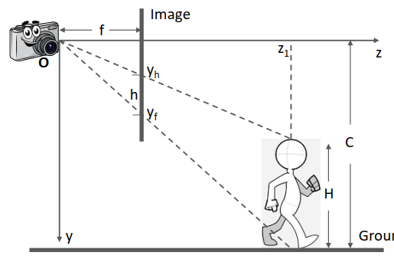
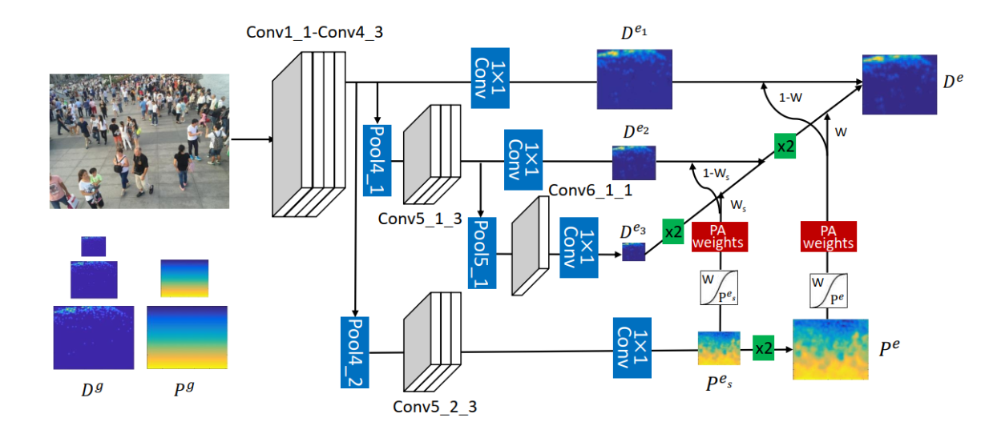
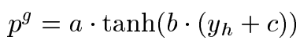
Revisiting Perspective Information for Efficient Crowd Counting
Architecture

Slide 26
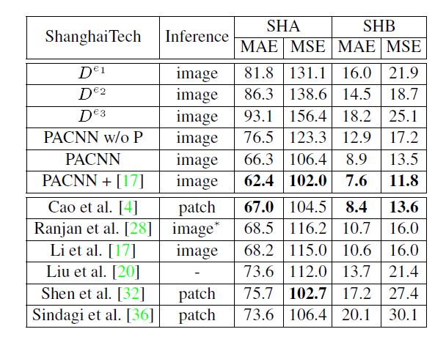
Revisiting Perspective Information for Efficient Crowd Counting
Results
Notes:
AMG VGG+Dilated DME VGG Deformable

Slide 27
Leveraging Heterogeneous Auxiliary Tasks to Assist Crowd Counting
Contributions
Leveraging three heterogeneous attributes compounded in the density map.
Formulating each attribute as an auxiliary task, which together provide joint regularization effects.
Notes:
AMG VGG+Dilated DME VGG Deformable

Slide 28
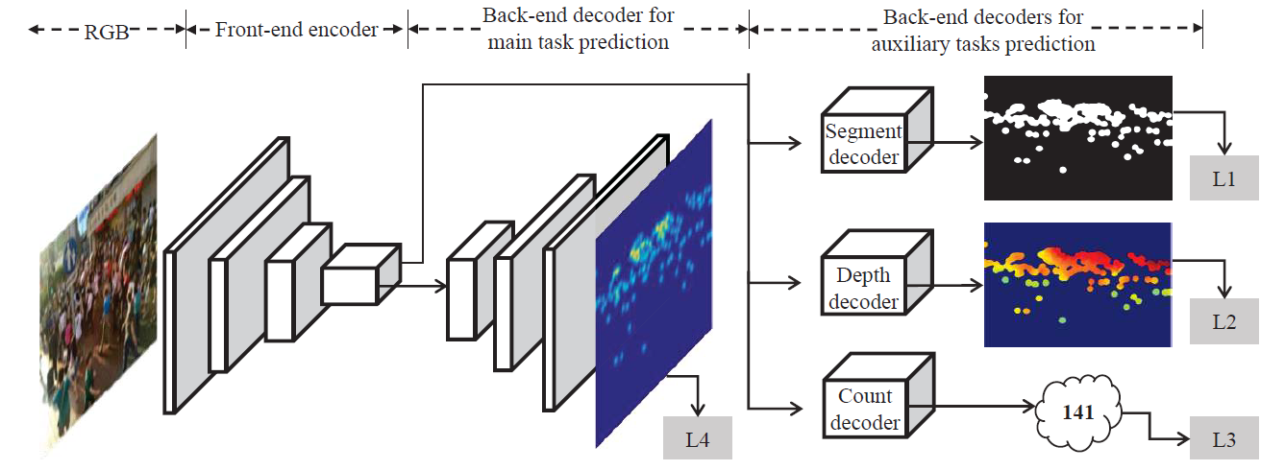
Leveraging Heterogeneous Auxiliary Tasks to Assist Crowd Counting
Architecture
Notes:
AMG VGG+Dilated DME VGG Deformable

Slide 29
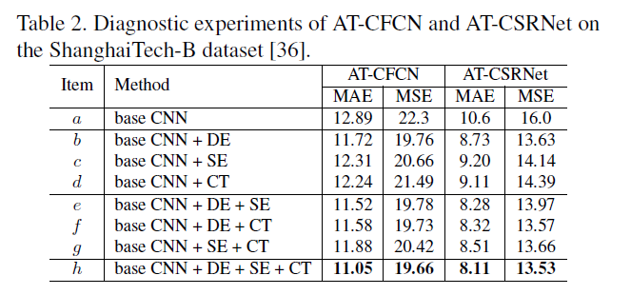
Leveraging Heterogeneous Auxiliary Tasks to Assist Crowd Counting
Results
Only on B subset?
Notes:
AMG VGG+Dilated DME VGG Deformable

Slide 30
Learning from Synthetic Data for Crowd Counting in the Wild
Contributions
Develop a data collector and labeler for crowd counting.
Present a pretrained scheme to facilitate the original method’s performance on the real data.
Propose a crowd counting method via domain adaptation.
Notes:
AMG VGG+Dilated DME VGG Deformable

Slide 31
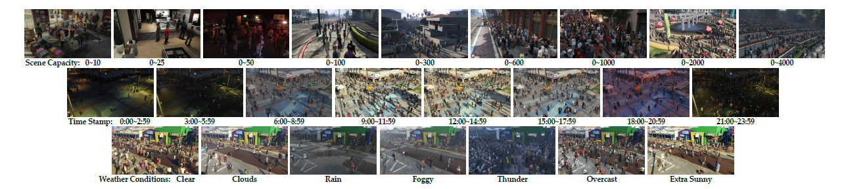
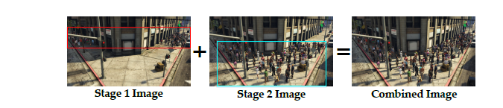
Learning from Synthetic Data for Crowd Counting in the Wild
Architecture

